Slide 1
How The Brain Learns
Emotional Memory and Logic:
Practical Uses in the Classroom

Slide 2
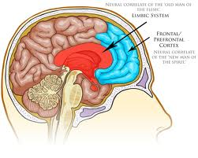
Do We Learn Better When Happy?
A New Paradigm: Emotional Logic— “students learn best when their minds, hearts, and bodies are engaged” (Jensen 82).
Emotions are linked to biological functions and processes
Limbic System
Pre-mammalian
Prefrontal Cortices
Cognitive Behaviors, Personality

Slide 3
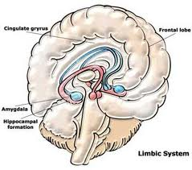
Limbic System
Thalmus—incoming sensory information (except smell)
Hypothalmus—regulates internal systems by controlling hormones (homeostasis)
Hippocampus—consolidates learning from working memory to long-term memory storage (looks for meaning)
Amygdala—attached to end of the Hippocampus, regulates interactions with environment that affect survival

Slide 4
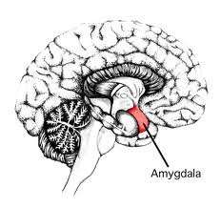
The Amygdala
A negative learning environment will cause a fight or flight response, or cause the learner to “shut down.”
Regulates interactions with the environment that can affect survival.
Since the Amygdala helps control the motor, sensory, and cognitive areas of the brain, its stimulation prioritizes our human response.

Slide 5
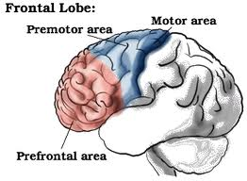
The Prefrontal Cortices
Deal with planning and thinking
Comprise the rational and executive control center of brain
Regulate emotional system
Contains self-will area, what can be called “personality”
Can develop later in adolescence

Slide 6
Fight or Flight or…Laugh?
Emotions link us to our environment to ensure survival.
Sensory Data → Brain→ Emotion and Intellect → Decision
Positive environments lead to: Endorphins in blood, which stimulate euphoria and stimulate frontal lobes (Sousa 84).
Negative environments lead to: Cortisol in blood, which raises anxiety level and refocuses frontal lobes to fight or flight (Sousa 84).

Slide 7
Positive Learning Environment
Create a brain-affirming learning climate
Affirm and recognize feelings and emotions
Provide more personal assignments
Allow learners to make individual choices
Use productive ritual to harmonize mind-body state
Maintain an absence of threat, stress, and artificial deadlines
Ensure resources are available to every learner
Use peer groups for review, feedback, and problem solving
Use self-assessment tools (non-threatening & metacognitive)

Slide 8
Brain Based Learning Activity: Rehearsal and Retention

Slide 9
Creating a non-threatening classroom
Greet students at the door; focus attention on students.
Design assignments that are realistic and achievable.
Provide support and motivation.
Provide regular and meaningful feedback on their progress.
Don’t ask questions looking for a “correct” answer from students. Create an open inquiry atmosphere.
When you ask a question, wait 5 seconds before responding
Structure activities and lectures in chunks

Slide 10
How to Package Learning: Chunking
After 20 minutes of learning the brain tires; at this point learners need “down time” to allow retention of information.
During down time learners can reflect, interact, do group work, or journal (say 5-10 minutes).
Be aware of the Primacy-Recency Effect.
Learners retain information given at the beginning and ending of class, or learning episode.
New and important information should be presented at the beginning and the end of class.

Slide 11
What can I do the first day?
Greet students as they enter
Show students you are emotionally invested in the class and in their success—make a connection.
Have a student-centered syllabus ready to go—be prepared.
Create a short presentation about yourself:
What you find funny
Favorite music
Places you’ve been
Intellectual interests
Facebook?

Slide 12
Reflections on Brain Based Learning
The combination of teaching and emotion can impact the brain and affect learning and retention of information.
What is one thing you learned about brain based learning today?
What will you incorporate in your classroom approach next week?
Information in this presentation is paraphrased or quoted from:
How the Brain Learns, 3rd Edition, by David A. Sousa
Brain-Based Learning: The New Paradigm of Teaching, Second Edition, by Eric Jensen

